Slide 1
10th Anniversary
Campaign Ideation
Revised Version Submitted 03.07.2025

Slide 2
Overview
The HCPLAN is celebrating its 10th anniversary in 2025. The purpose of this document is to explore opportunities to celebrate this milestone and continue advancing the mission of the HCPLAN.
GOALS
COMMUNICATION CHANNELS
Celebrate | Celebrate the milestone of
HCPLAN’s decade of progress advancing accountable care
Website
Social Media
Deepen Engagement | Deepen key audience engagement in HCPLAN and understanding of payment reform among general audiences
Email Marketing
Media and C2C Network
Elevate HCPLAN’s Leadership | Elevate the HCPLAN’s position as a leader in health care transformation
Events

Slide 3
Sample Messaging
Below is sample messaging that aligns with the identified communications goals.
Celebrate
Celebrate the milestone of HCPLAN’s decade of progress advancing accountable care
Deepen Engagement
Deepen key audience engagement in HCPLAN and understanding of payment reform among general audiences
Elevate HCPLAN’s Leadership
Elevate the HCPLAN’s position as a leader in health care transformation
Celebrate 10 years of HCPLAN leading transformation through value-based care!
HCPLAN has helped value-based care evolve from a new concept to an established business imperative.
The HCPLAN has built momentum for another decade of progress further expanding accountable care
Join forces with the HCPLAN to participate in the next decade of health care transformation.
A more patient-centered, efficient, and sustainable health care system is within reach; we must act now!
The HCPLAN brings people together to building the foundations for alignment between core partners in payment reform.
As a convener, thought leader, and communicator, the HCPLAN has played a pivotal role in building the foundations for successful collaboration among core partners in payment reform.

Slide 4
Recommended Package of Tactics
Channel | List of Recommended Tactics | Goals
Website | 10th Anniversary Branding and Landing Page
 | Infographic Timeline (non-interactive)
Social Media | Video (scripted): “Decade in Review” (existing footage)
 | >60 second reel: Interview with HCPLAN members and previous Summit attendees
 | Measurement Effort results over the years
 | Interactive content to encourage audience engagement (e.g., polls, collaborative threads)
Email Marketing | Email campaign (3 emails) for new and current subscribers
Media & C2C Network | Communications Kits for C2C partners
 | Pitch op-ed and podcast speaking appearances for HCPLAN leaders
Events | Branded presentation materials (virtual events)
 | Branded 2025 Summit materials (e.g., pins, wall cling, signage, name badges, etc.)
Celebrate
Deepen Engagement
Elevate HCPLAN’s
leadership
Note: This package complements general communications for the HCPLAN.

Slide 5
Opportunities to Enhance Tactics Package
Channel | Subset of Recommended Tactics | Enhancement Opportunity | Goals
Website | Infographic Timeline (non-interactive) | Make the timeline interactive.
Social Media | Video (scripted): “Decade in Review” (existing footage) | Incorporate additional recorded interviews featuring long standing members.
 | >60 second reel: Interview with HCPLAN members and previous Summit attendees | Q&A w/ HCPLAN leaders highlighting the importance of joining the VBC movement.
 | Measurement Effort results over the years | Include commentary from participating organizations reflecting on impact over the past 10 years. Incorporate more interactive elements for engagement. Consider “scrolly telling” elements for the Measurement Report.
 | Interactive content to encourage audience engagement (e.g., polls, collaborative threads) | Call-to-action campaign - 10 action small but impactful actions to advance VBC.
Email Marketing | Email campaign (3 emails) for new and current subscribers | Email campaign (4 emails) for new and current subscribers – w/ content from HCPLAN leaders.

Slide 6
Sample Timeline
APRIL
Pitch Op-ed
JUNE
Launch “10 Reasons to Join HCPLAN”
Send email #2
AUGUST
Publish 4 static graphics
Send email #4
OCT
No new content; buffer for Summit prep
MARCH
Receive approval for Comms Plan and Initiate Tactic Planning & Implementation
MAY
Branding live on site
Launch “VBC Over the Years”
Send announcement to C2C partners
Send email #1
JULY
Publish scripted reel
Send email #3
SEPT
Launch infographic timeline on site
Publish video: “Decade in Review”
Distribute Comms Kits
Pitch Podcasts
NOV
2025 Summit w/ branded materials

Slide 7
Key Performance Indicators
Measuring the success of the 10th anniversary campaign will require a mix of quantitative and qualitative metrics across all channels.
  Website
Overall site traffic and unique visitors
Page views & unique visitors to anniversary specific content
Website traffic to the subscription webpage – referral sources and conversion
  Social Media
# Followers
# Video views
Hashtag use
Total reach & impression of campaign posts
Resource downloads
& page views
Engagement & reach
  Email Marketing
# of new subscribers during campaign period
Open rates & click-through rates for campaign emails
Unsubscribe rates
  Media
# of op-eds
# of podcast appearances
# of times HCPLAN cited in earned media
  Events
Event registration & attendance
New & returning attendees
Post-event surveys & participant feedback

Slide 8
Next Steps
Conduct internal review and refinement of proposed comms plan
Share recommendations with CMMI
Adjudicate feedback and finalize comms plan
Begin execution

Slide 9
Proposed Communications Activities

Slide 10
Website
The website will feature 10th anniversary branding and anniversary-specific content across hcplan.org to promote HCPLAN as the go-to resource for value-based care (VBC) information and an established thought leader in this space.
Proposed Activities:
10th anniversary branding for display across all channels (e.g., emails, newsletter, website, social media, presentations, event styling, etc.) to create a consistent look and feel and mark the distinction of the anniversary
  See appendix for mockups
Interactive, digital timeline that highlights the evolution of key HCPLAN resources and initiatives to show progress over time
Note: General website redesign activities are not included in this proposed plan.

Slide 11
Website
Short-Term (4-8 wks. of production)
Medium-term (6-8 wks. of production)
Long-term (12 wks. of production)
Concept | Activity | Time | Description
10th Anniversary Branding | Branding web updates | Short | Updated hcplan.org header with a dark blue background. 10th Anniversary logo added Timer countdown to the summit
 | 10th anniversary landing page + animated elements | Medium | Includes everything under Short Time plus: 10th Anniversary landing page that highlights key milestones, achievements, and impact
10-Year Timeline | Infographic Timeline | Medium | Infographic timeline that highlights the evolution of key resources and initiatives. Refreshed the About Us webpage to include infographic timeline highlighting key resources, HCPLAN progress over time, including measurement effort results.
 | Interactive Timeline | Long | Animated (moving graphics, hot spot text) timeline that highlights the evolution of key resources and initiatives. Incorporate interviews from HCPLAN co-chairs, members and organizations that contributed and/or benefited from the resources. Refreshed the About Us webpage to include interactive timeline highlighting key resources, HCPLAN progress over time, including measurement effort results. Badges for resources to link back to the timeline for more historical information (e.g., badge on the Accountable Care Curve page links to the timeline page)

Slide 12
Social Media
Social media will include one or more anniversary-branded series of content highlighting HCPLAN milestones and success stories. This content can be shared via HCPLAN and partners’ social media accounts (#HCPLAN10) using new media types to drive engagement.
Proposed Activities:
10 Years of Alignment, Action, & Change | Storytelling series highlighting HCPLAN’s contributions to value-based care over the past decade
Collaborating for a Healthy Future | Series highlighting a person-centered approach to preventive care and the impact of value-based care across the health care system
HCPLAN Drives Accountable Care | Series highlighting HCPLAN members’ lessons learned and promising practices
Voices of HCPLAN | Series featuring stakeholders who have benefited from HCPLAN initiatives

Slide 13
Social Media
Short-term (4 wk. production)
Medium-term (12 wk. production)
Long-term (16+ wk. production)
Concept | Time | Description
10 Years of Alignment, Action, & Change | Short | Add logo to all content (1) video - Scripted voice over “decade in review” video using the 5th Anniversary video, b-roll from Summits, Summit interviews and clips, and 2023 and 2024 Year in Review footage only. (10) posts with text and static graphics that highlight (10) resources, VBC success stories, or infographic highlighting the Measurement Effort results over the years. Compilation of individual “Join us as we improve payment to improve lives” videos from 2024 Summit, with call-to-action for followers to subscribe to HCPLAN. :60 second animated reel showing VBC throughout the healthcare system and the positive impact on patients.
 | Medium | Compilation video of (10) HCPLAN members and partners sharing 10 reasons to join HCPLAN. This series takes place over 10 days as a countdown to the Summit. Communication kits (email/document) for participating members to highlight content in which they appear and the anniversary.
 | Long | Three-part scripted animated docuseries on social media that provides a behind-the-scenes look at the development of key resources and strategic initiatives, highlighting impact of VBC. Each episode lasts <2 minutes and includes clips from previous HCPLAN events, Summit interviews, and videos. Communication kits (web landing page) for participating members to highlight content in which they appear and the anniversary.

Slide 14
Social Media
Low (8 wk. campaign, Sept.-Nov.)
Medium (12 wk. campaign, Aug.-Nov.)
High (16 wk. campaign, July-Nov.)
Concept | LOE | Description
Collaborating for a Healthy Future | Short | Animated infographic showing Measurement Results over the years, including covered lives. (4) posts with static graphics highlighting the success of VBC improving patient outcomes through HCPLAN members/organizations over the past 10 years.
 | Medium | (1) Scripted reel no longer than 90 seconds featuring (1) HCPLAN influencer sharing 3 examples of how collaboration across the industry has led to improved patient outcomes in their work.
 | Long | (1) Scripted 3-minute video featuring (4) health care providers sharing their experiences collaborating access the industry to provide more efficient care to prevent chronic diseases. Communication kits for participating members to highlight their video.
HCPLAN Drives Accountable Care | Medium | (1) Scripted reel highlighting (2) HCPLAN influencers-why they joined, how HCPLAN has helped them, what they’re looking forward to.
 | Long | Recorded conversation with Mark McClellan or other HCPLAN leaders sharing how the HCPLAN has evolved over the years, how the health care industry has benefited from HCPLAN, key takeaways and lessons learned, and what he’s looking forward to in the next phase of health care transformation.
Voices of HCPLAN | Medium | “Voices of HCPLAN” three-video series (2-3 min. each) featuring three stakeholders who have benefited from HCPLAN initiatives.

Slide 15
Email Marketing
An email marketing effort will launch a 10th anniversary email campaign journey for both current and new subscribers, incorporating a more personal and authentic voice to communicate HCPLAN key messages as well as more visual elements.
Proposed Activities:
Series of emails of new and current subscribers to take them along the journey of engaging with HCPLAN resources and events.

Slide 16
Email Marketing
Medium-term (4 wks. production)
Long (6-8 wks. production)
Concept | Time | Description
Email Campaign for New and Current Subscribers | Medium | New Subscribers (sign up after March 1, 2025): Email 1: 10th Anniversary announcement Email 2: 10 Years of Alignment, Action, and Change: Highlight HCPLAN’s role in value-based preventative care. Email 3: Collaborating for a Healthy Future: Featured influential member or strategic initiative impact story highlighting partnerships that were formed to advanced VBC. Current subscribers: Email 1: 10th anniversary announcement Email 2: Early bird access to Summit registration as a thank you for their membership.
 | Long | Current Subscribers: Email 1: Personalized email from Executive Forum co-chairs announcing 10th anniversary. Email 2: Personalized letter from Mark McClellan emphasizing 10 Years of Alignment, Action, and Change, thanking members for their support, and unveiling the interactive timeline. Email 3: Feature story influential member or strategic initiative impact story highlighting partnerships that were formed to advanced VBC. Email 4: Early bird access to new resource or Summit registration as a thank you for their membership. New Subscribers: Email 1: Personalized welcome letter from Executive Forum co-chairs announcing 10th anniversary. Email 2: Personalized letter from Mark McClellan highlighting his longevity with HCPLAN ,the HCPLAN impact over 10 years, the library of resources, and introduces the interactive timeline. Email 3: Email from Dr. Judy Zerzan-Thul celebrating HCPLAN as a leader in providing resources to guide stakeholders along their journey; highlights 1 impact story of a provider/org. using HCPLAN resources.

Slide 17
Media and C2C Network
Media outreach to target health care publications and partnerships with health care influencers can increase HCPLAN’s reach and raise awareness/increase engagement with HCPLAN resources.
Proposed Activities:
Earned media, including op-ed series and podcasts/guest appearances for co-chairs, to raise awareness about HCPLAN
Media kits with fact sheets, pre-written social media content, branded graphics, etc. to support partners and influencers in amplifying HCPLAN content
Speaking opportunities for HCPLAN leaders at health care community events

Slide 18
Media and C2C Network
Concept | Time | Description
Thought Leadership | Short | Pitch a targeted list of health care podcasts and coordinate guest appearances for co-chairs.
 | Medium | Pitch an op-ed series (e.g., “Lessons from a Decade of Value-Based Care”) and pitch key HCPLAN leaders for interviews.
Influencer Amplification | Short | Provide comms kits with prewritten tweets, LinkedIn posts, video scripts, and branded graphics to C2C partners.
 | Medium | 10th anniversary landing page with downloadable media kits with fact sheets and logos with usage guidelines
Health Care Community Events | Medium | Pitch speaking opportunities for HCPLAN leadership to participate as HCPLAN representatives and thought leaders to share key milestones and resources.

Slide 19
Events
Events can highlight HCPLAN’s 10th anniversary milestone at in-person events to reinforce the campaign and increase engagement. The team can identify creative ways to use the number ’10’ as a motif throughout different types of activities (e.g., 10 conversation starters, 10 key milestones, etc.).
Proposed Activities:
10th anniversary branding/styling for in-person events (e.g., 2025 Summit) and virtual events throughout the year to mark the milestone

Slide 20
Events
Short-term (~2 months to complete)
Medium-term (4+ months to complete)
Long-term (6+ months to complete)
Concept | Time | Description
10th Anniversary Branding (in-person events) | Short | Poster board sessions featuring key milestones 10th anniversary branding on nametags 10th anniversary branding on signage
 | Medium | Wall clings highlighting key milestones Photo booth with 10th anniversary frame
 | Long | Interactive digital resources with touch screen
10th Anniversary Branding (virtual events) | Short | Incorporate 10th-anniversary branding on PowerPoint presentations in-person and virtual events
 | Short | Reference the 10th anniversary in talking points for opening/closing remarks

Slide 21
10th Anniversary Branding

Slide 22
Branding Overview
This section includes working drafts of:
Four proposed taglines
Four proposed HCPLAN 10th anniversary logos with visual examples of how to incorporate the selected logo into the HCPLAN’s existing communication channels and brand materials.
We paired logos with logomarks to maximize versatility in design and usages. Examples include:
Full Logo:
Website
Presentations
Newsletter and Email Banners
Logomark:
Summit Pin
Social Media
Mobile App

Slide 23
Tagline Options
Recommended: Alignment, Action, Change: Advancing Value-Based Care
Partners Advancing Accountable Care
Shaping the Future of Health Care
A Decade of Impact: Advancing Accountable Care

Slide 24
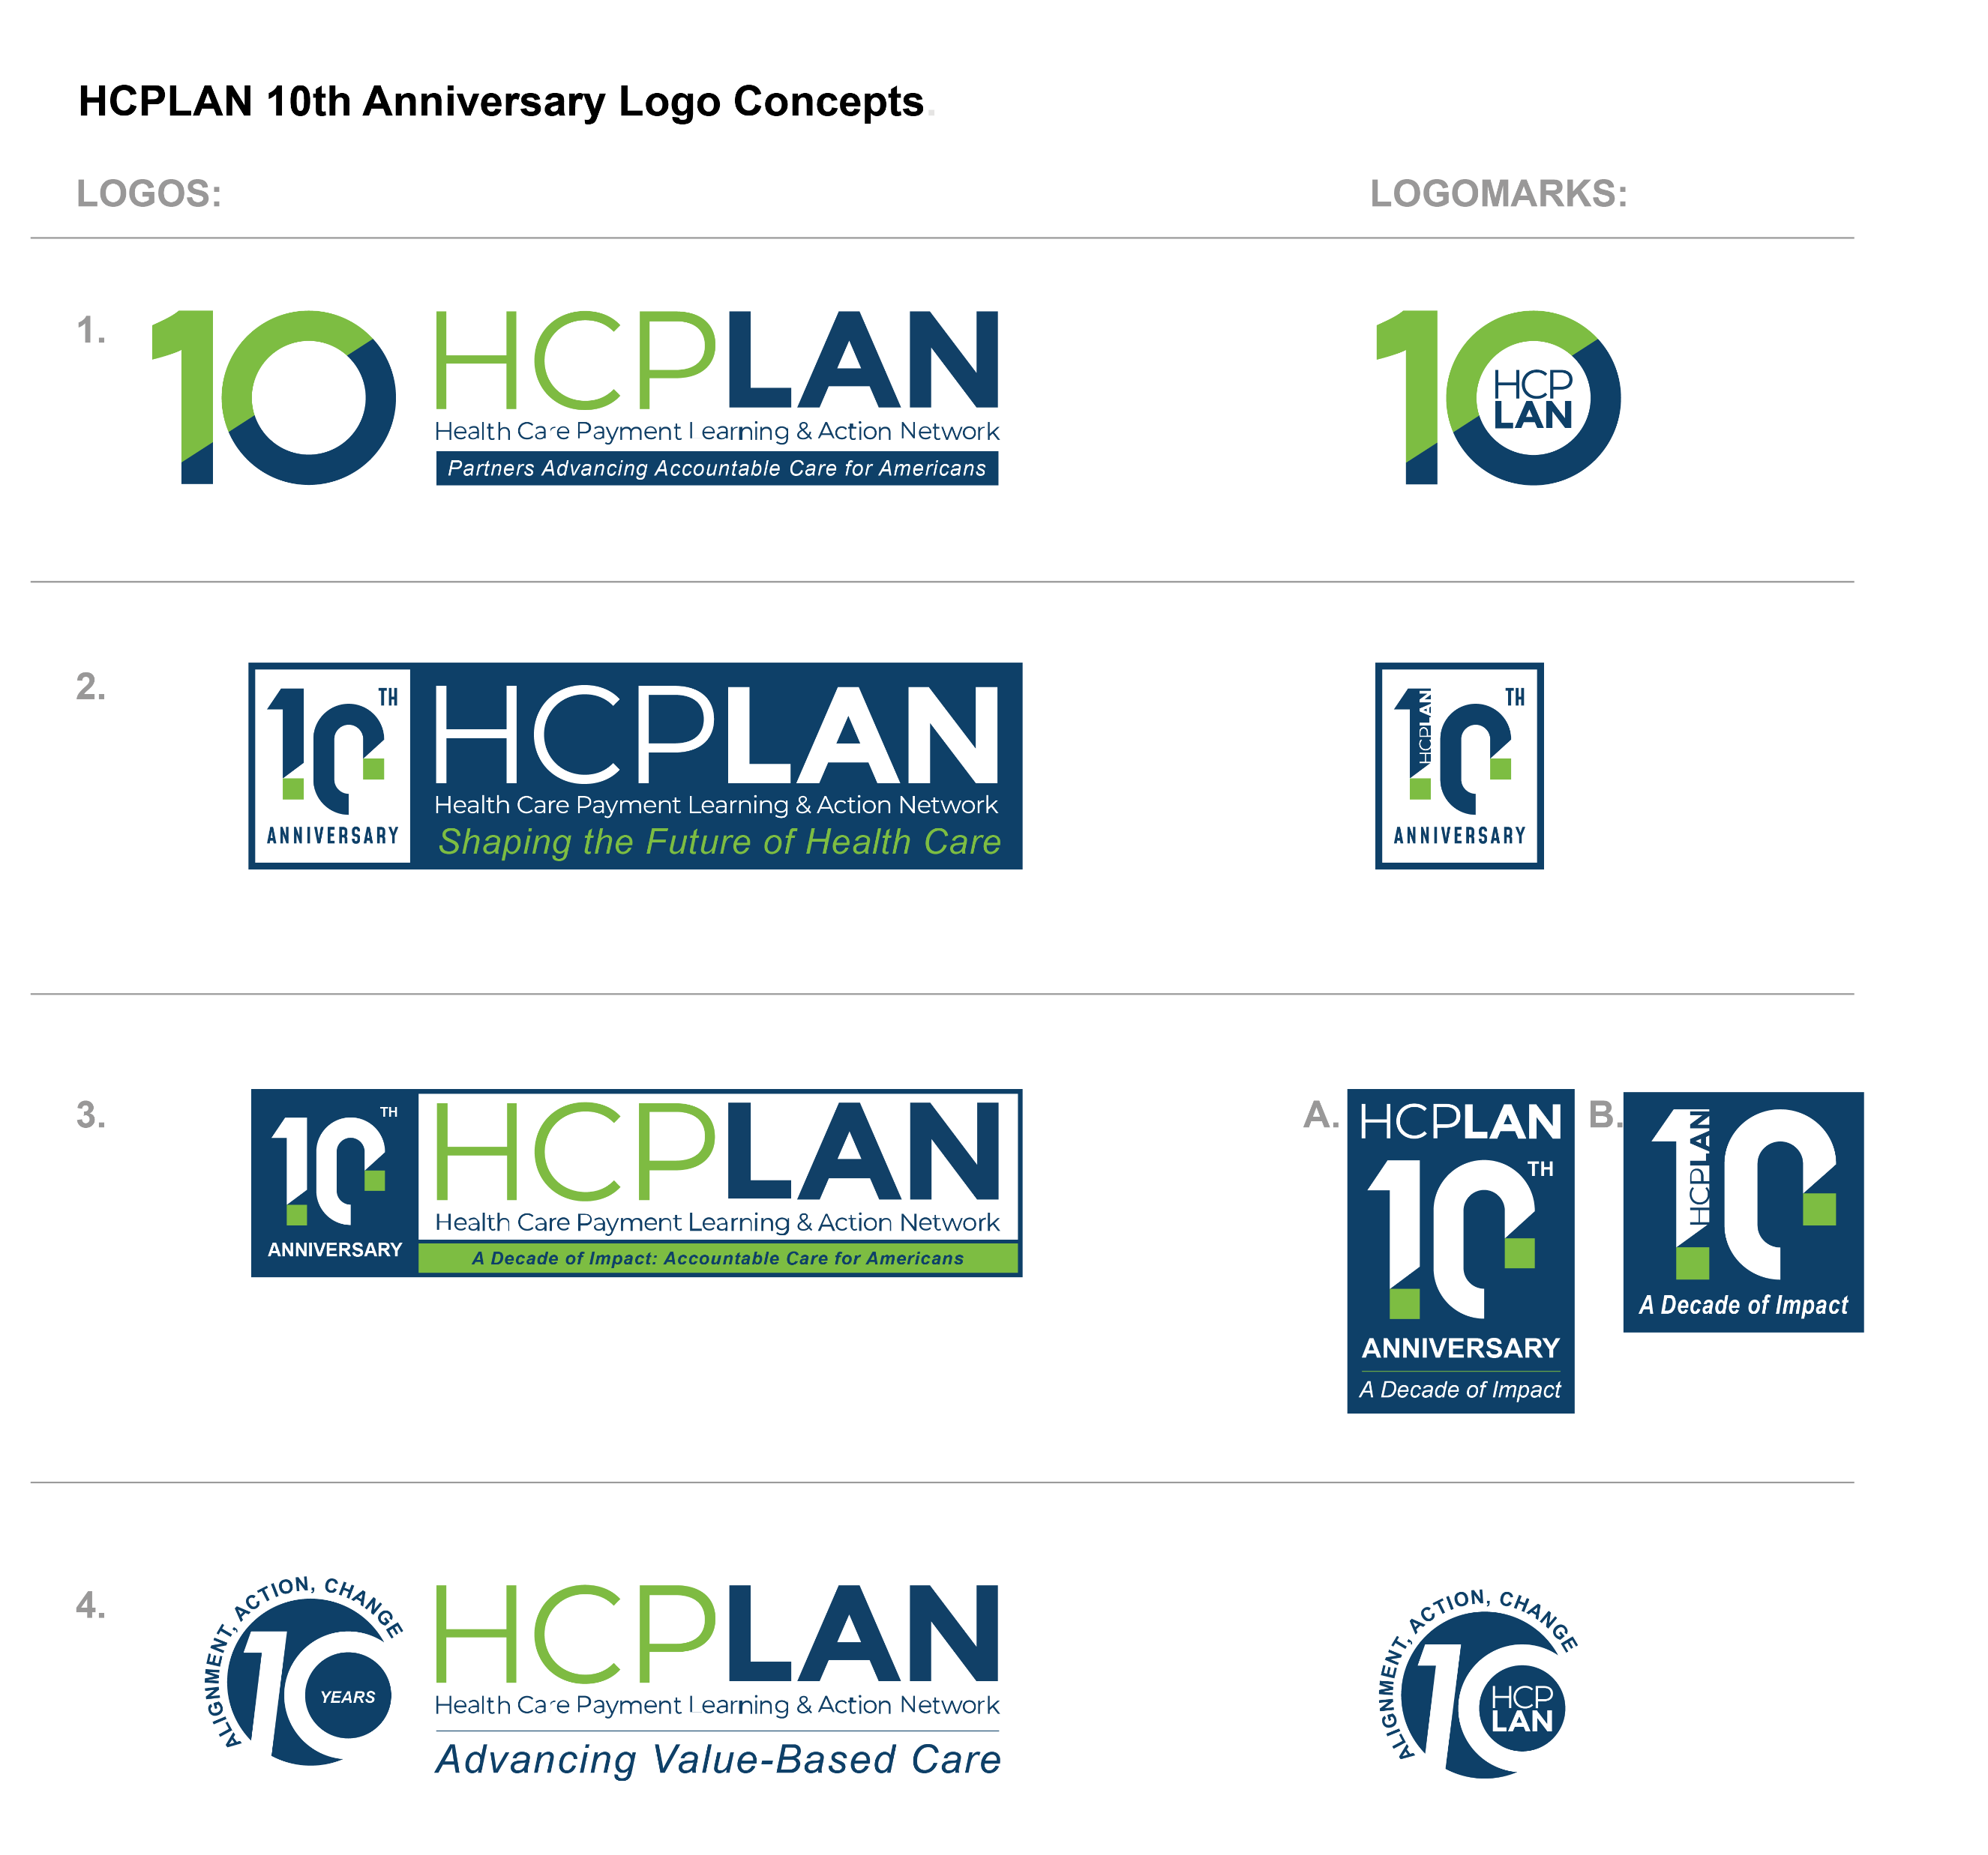
Logo Concepts

Slide 25
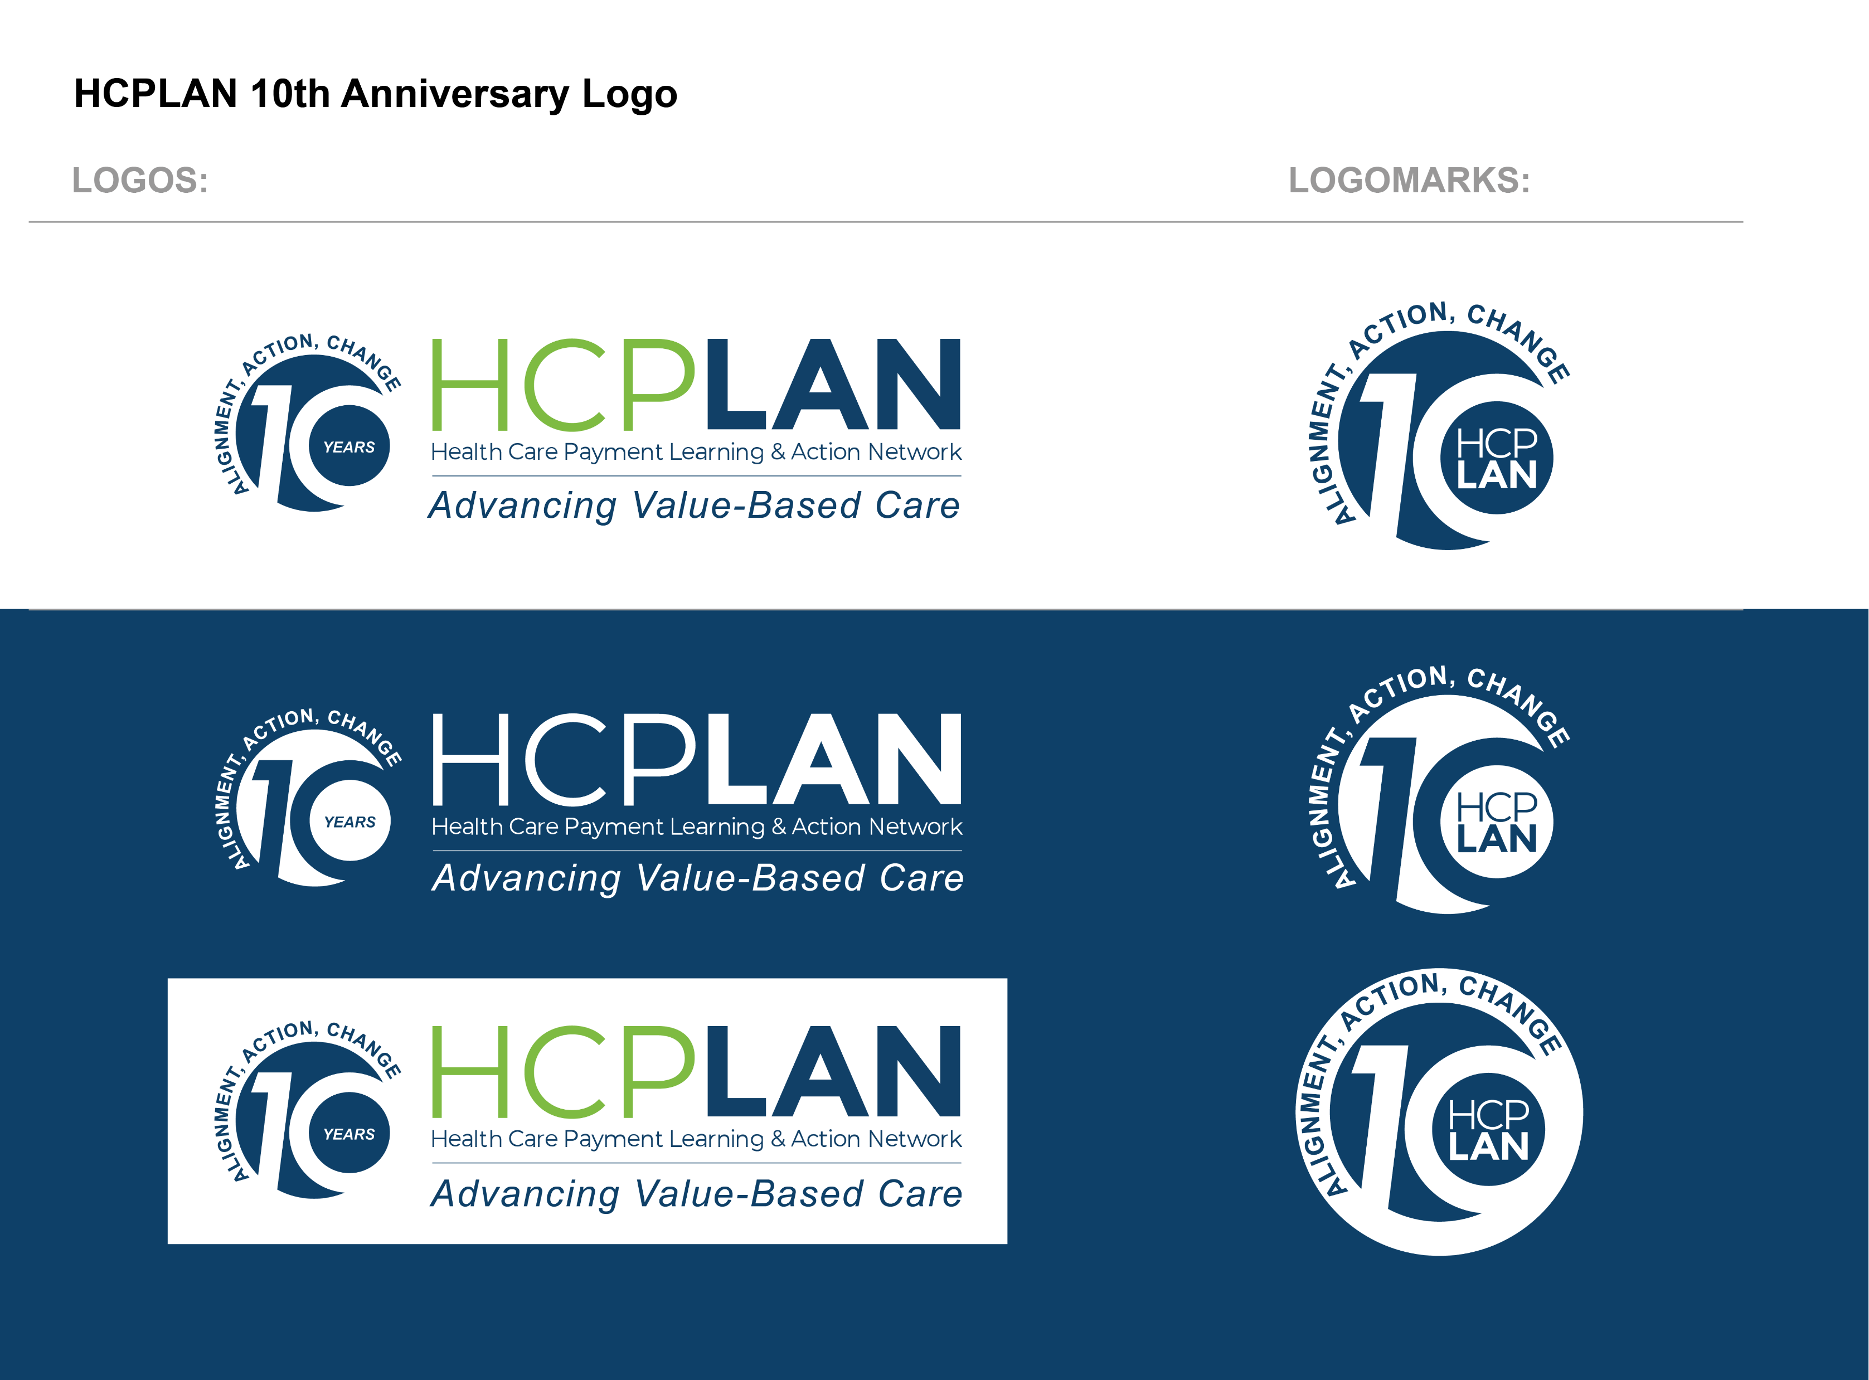
Recommended
Logo

Slide 26
Visual Examples by Channel

Slide 27

Website

Slide 28


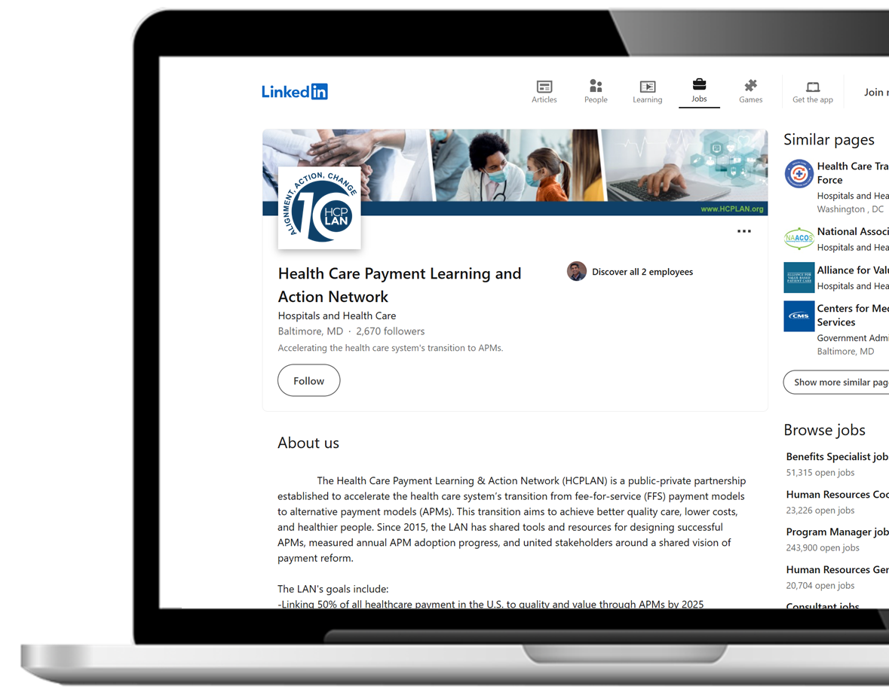




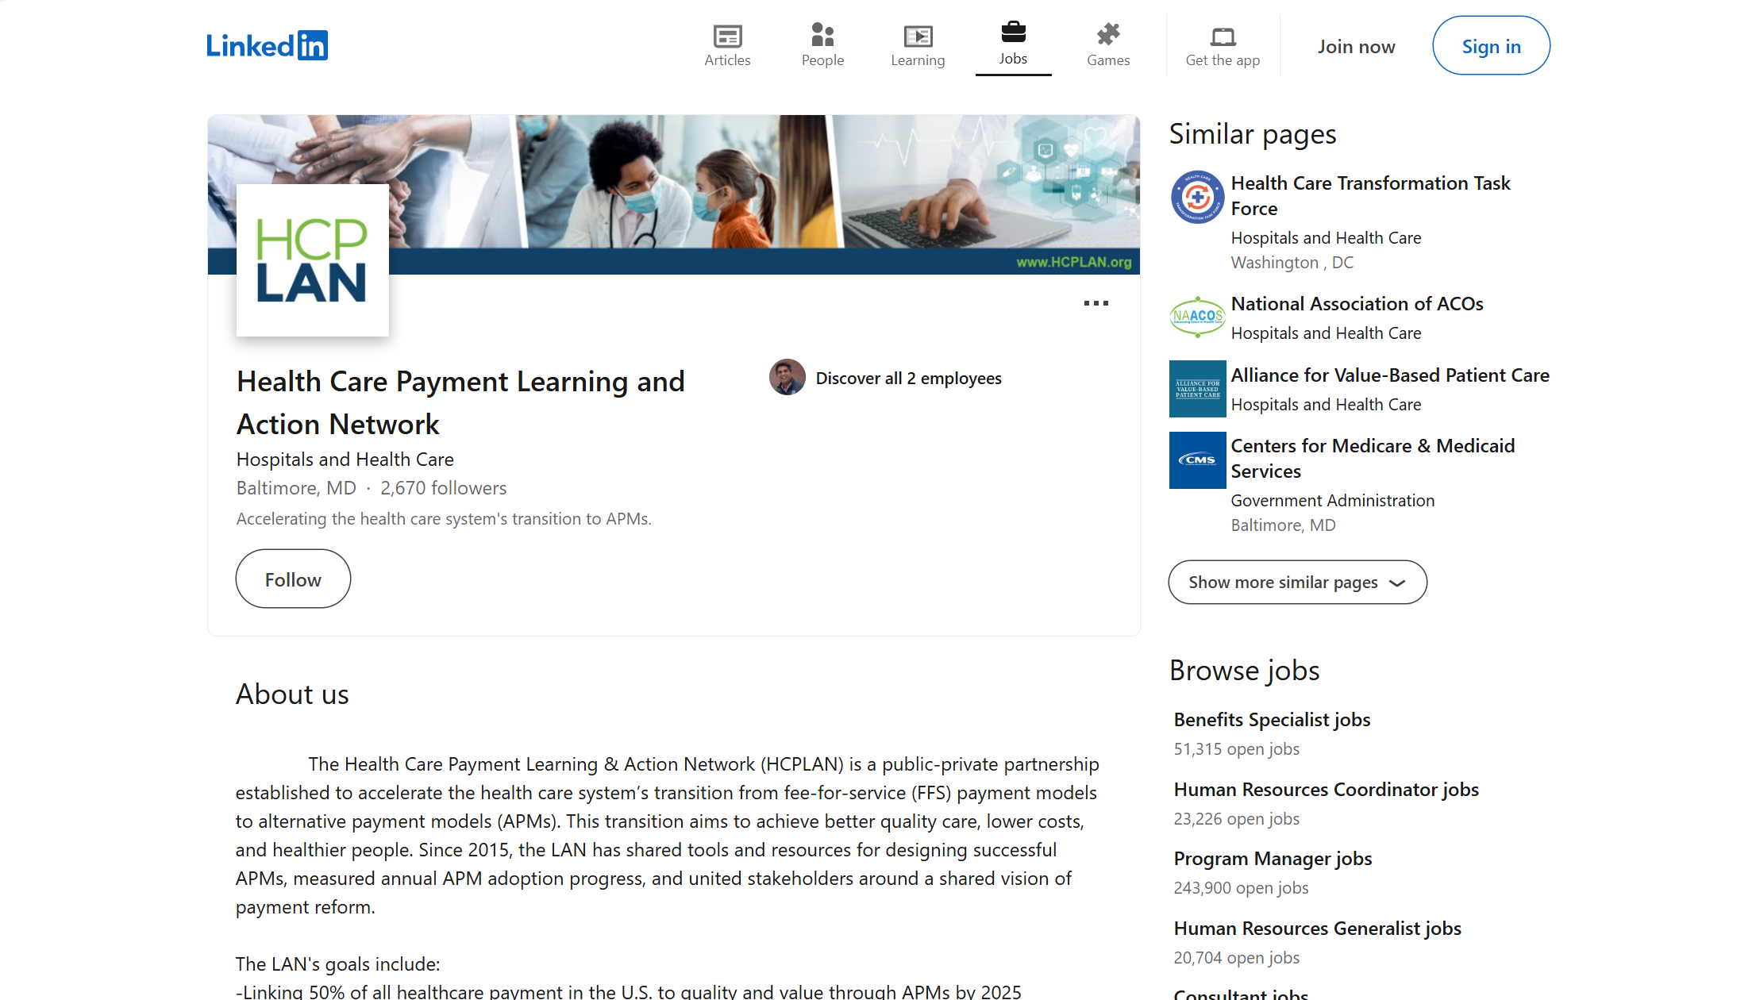

Social Media

Slide 29
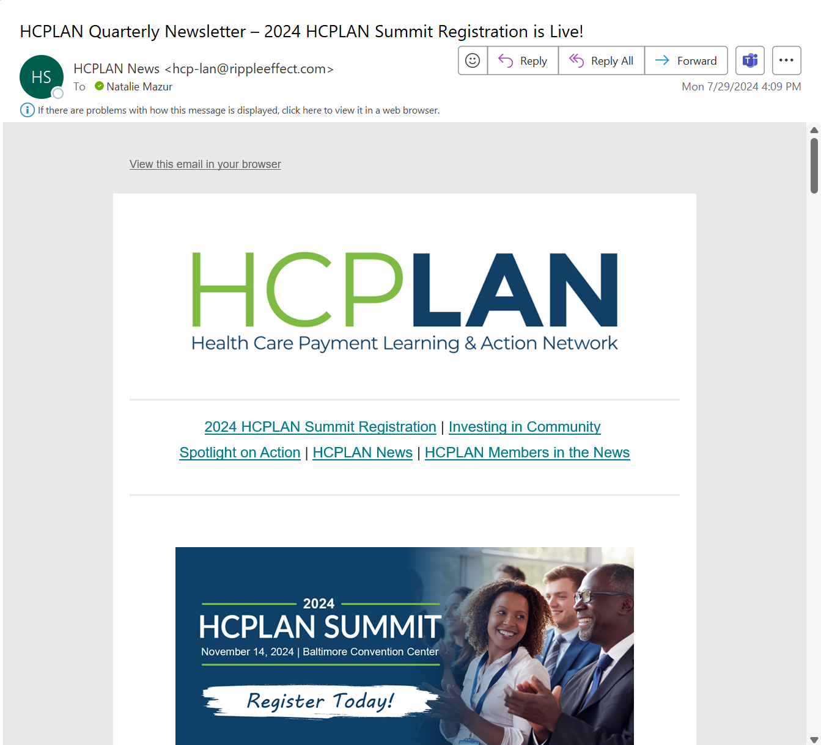
Newsletter & Email Signatures
Examples of how HCPLAN Operators can implement branding in email signatures.
HCPLAN Operator Team
HCPLANSupport@rippleffect.com
HCPLAN Operator Team
HCPLANSupport@rippleffect.com
Notes:
Play with opacity

Slide 30
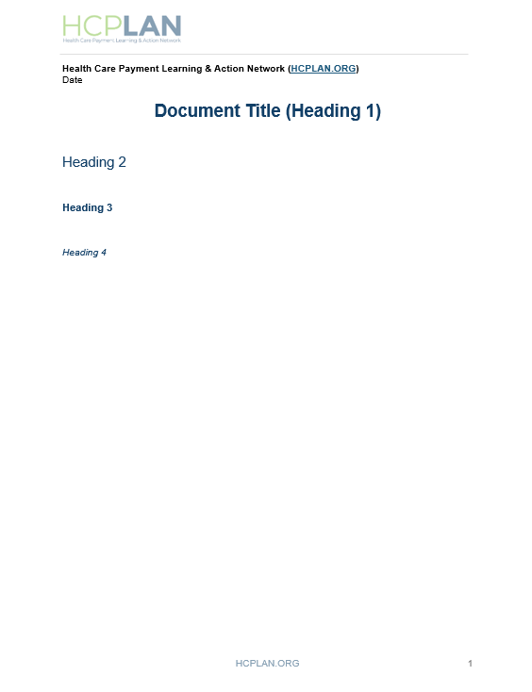


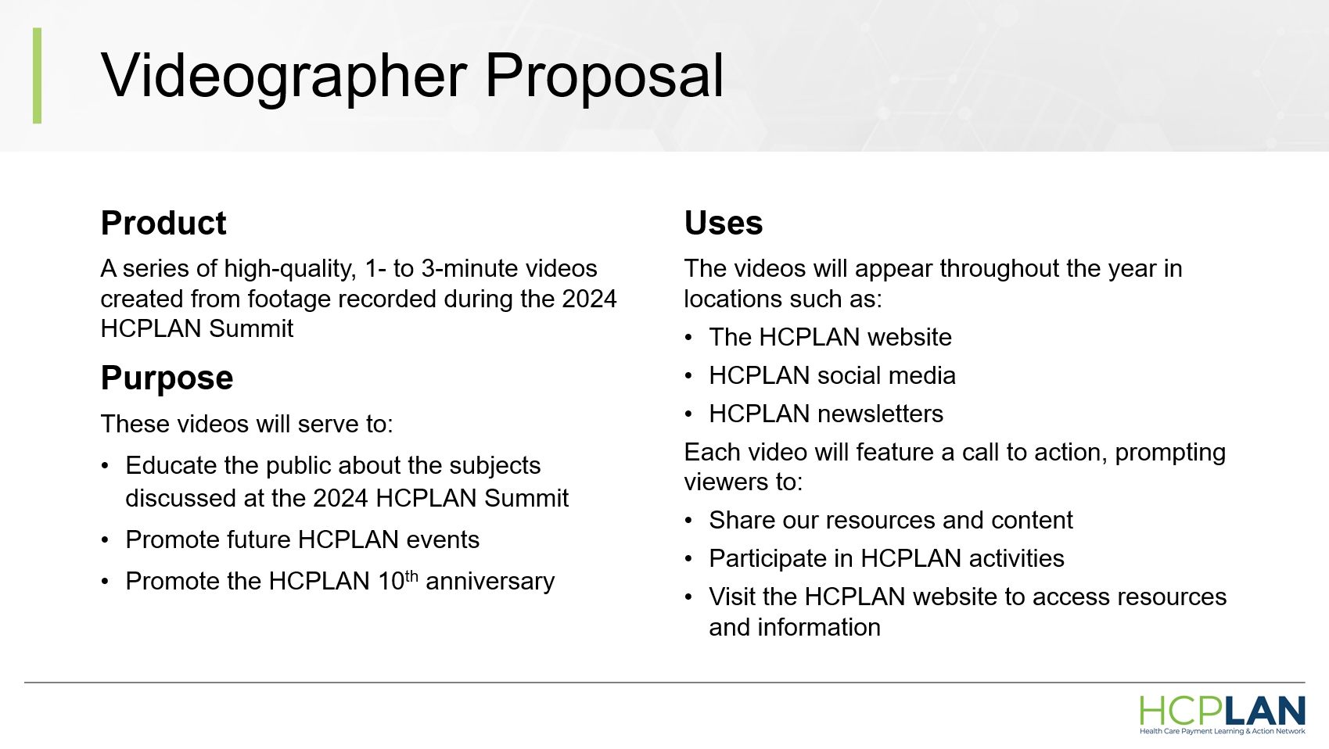

Presentation & Documents

Slide 31


Event Materials

Slide 32
Sample Messaging
Celebrate 10 years of HCPLAN leading transformation through value-based care!
As a convener, thought leader, and communicator, the HCPLAN has played a pivotal role in successfully building the foundations for alignment between core partners in payment reform.
Almost 30% of U.S. health care payments flowed through downside risk contracts in 2023 and the HCPLAN has built momentum for another decade of progress further expanding accountable care in the U.S.
Join forces with the HCPLAN to participate in the next decade of health care transformation.

Slide 33
Short-Term Tactics
Concept | Description | C2C and HCPLAN Partners | Earned Media | Email | Events | Social Media | Website
10 Year Video | Scripted voice over “decade in review” video with animation.
Improve Payment to Improve Lives | “Join us as we improve payment to improve lives” compilation clip from 2024 Summit
Anniversary Pins | Event giveaway for all attendees.
Paid Media | Consider opportunities such as sponsored articles or strategically timed paid promotion to expand reach.

Slide 34
Mid-Term Tactics
Concept | Description | C2C and HCPLAN Partners | Earned Media | Email | Events | Social Media | Website
10 Reasons to Subscribe | Video series featuring (10) members and partners sharing 10 reasons to subscribe to HCPLAN.
HCPLAN Impact on VBC | Animated timeline reel highlighting HCPLAN’s actions and milestones to drive VBC and support the healthcare system.
Town Hall | Subscribers-only Town Hall to discuss VBC through policy transitions.
Regional Town Halls | Feature panelists to share how HCPLAN work was influential.
Op-ed series | Lessons from a Decade of Value-Based Care cowritten by key HCPLAN leaders.

Slide 35
Long-Term Tactics
Concept | Description | C2C and HCPLAN Partners | Earned Media | Email | Events | Social Media | Website | Concept
Future of VBC Series | Series featuring member organizations reflecting on VBC in present day, and the next 10 years.
Interactive Timeline | An interactive tool that always users to explore HCPLAN milestones and the progression of documents and initiatives.
Leadership Series | Featuring HCPLAN co-chairs reflecting on the inception of HCPLAN and the impact it has had in supporting organizations in patient-centered care.

Slide 36
Archive (Delete in Final Version)

Slide 37
Recommended Communications Tactics
The recommended package of communications tactics requires a relatively lower level of effort to execute while still consistently promoting the 10th anniversary throughout the year in new and creative ways:
Comms Channel | Tactics Option 1 - RECOMMENDED | Tactics: Option 2
Website | 10th Anniversary Branding and Landing Page Infographic Timeline (non-interactive) | 10th Anniversary Branding and Landing Page Interactive Timeline
Shareable Content* *Distributed via social media, email, C2C Network, events, and website) | Video (scripted): “Decade in Review” (existing footage) Video (non-scripted): 10 Reasons to Join the HCPLAN Targeted Audience Infographics (4): The role of VBC on patient outcomes Reel: Interviews with HCPLAN members Social Media Campaign: Measurement Effort results Animated Infographic: VBC 101 | Video (scripted): “Decade in Review” (existing footage) Video (scripted): Collaborating for a Healthy Future Video (non-scripted): 10 Reasons to Join the HCPLAN Video (scripted): Q&A w/ HCPLAN leader Social Media Campaign: Measurement Effort Results Animated Infographic: VBC 101
Email Marketing | Email campaign (3 emails) for new and current subscribers | Email campaign (4 emails) for new and current subscribers – w/ content from HCPLAN leaders
Media & C2C Network | Communications Kits for C2C partners Pitch op-ed and podcast speaking appearances for HCPLAN leaders | Communications Kits for C2C partners Pitch op-ed and podcast speaking appearances for HCPLAN leaders
Events | Branded presentation materials (virtual events) Branded 2025 Summit materials (e.g., wall cling, signage, name badges, etc.) | Branded presentation materials (virtual events) Branded 2025 Summit materials (e.g., wall cling, signage, name badges, etc.)

Slide 38
Recommendation 1
Channel | March | April | May Announce Anniversary | June | July | Aug | Sept | Oct
Website Branding | Develop and submit landing page website branding mockups for approval | Approval received. Develop, test, and approve landing page | All branding elements live on website
Interactive Timeline |  | Develop concept | Submit v1 for approval Submit v2 for approval Submit final version for approval Approval received, production begins | Production continues | Production continues | Submit for approval | Additional testing and edits as needed. | Launch interactive timeline
Sharable Content | Submit logo for approval Receive approval | Add logo to all Evergreen and ad hoc content | Publish content with logo |  |  |  | Promote interactive timeline
10 Years of Alignment, Action, & Change |  |  |  |  | Develop and submit and script storyboard for review Review final edits | Begin video production Submit first version Submit second version | Submit final version Receive approval Publish on social media, YouTube, and website
 |  | Solicit members to participate in 10 Reasons Why to participate with HCPLAN Draft script and submit for approval | Script approved Confirm interview Begin recording Edit videos Submit for approval | Receive approval Launch series on social media
 | Create storyboard for “VBC over the years” reel Draft script and submit for approval | Storyboard and script approved Begin production Submit final reel for approval | Launch series on social media
Collaborating for a Healthy Future |  | Research providers within HCPLAN to interview on collaboration | Receive approval on (4) providers to interview Develop and submit script for approval | Coordinate providers interviews Edit footage | Submit videos for review and approval | Launch series on social media and YouTube
HCPLAN Drives Accountable Care | Solicit Mark McClellan and HCPLAN leaders | Develop talking points Submit or approval | Provide talking points to participants for review Schedule recording | Host recordings Edit video | Submit video for review and approval | Receive approval | Publish on social, YouTube, and website
Email Marketing | Draft emails and submit for approval | Receive approval | Send email 1 |  | Send email 2 |  | Send email 3
Media & C2C | Pitch op-ed Lessons from a Decade of Value-Based Care and HCPLAN leaders |  | Send anniversary announcement to all C2C partners |  | Develop comms kits | Submit comms kits for approval | Distribute comms kits Pitch podcasts to feature HCPLAN leaders
Events | Develop branded presentation decks | Receive approval on decks | Develop wall cling concept | Submit wall cling concept for approval Send wall green to production | Develop branded name tags and signage |  | Reference anniversary in talking points

Slide 39
Recommendation 1
Channel | March | April | May Announce Anniversary | June | July | Aug | Sept
Website Branding | Develop and submit landing page website branding mockups for approval | Approval received. Develop, test, and approve landing page | All branding elements live on website
Infographic Timeline |  |  | Develop concept | Submit v1 for approval Submit v2 for approval | Approval received, production begins | Submit for review Additional edits as needed Approval received | Launch on website
Sharable Content | Submit logo for approval Receive approval | Add logo to all Evergreen and ad hoc content | Publish content with logo
10 Years of Alignment, Action, & Change |  |  |  |  | Develop and submit and script storyboard for review Review final edits | Begin video production Submit first version Submit second version | Submit final version Receive approval Publish on social media, YouTube, and website
 |  | Solicit members to participate in 10 Reasons Why to participate with HCPLAN Draft script and submit for approval | Script approved Confirm interview Begin recording Edit videos Submit for approval | Receive approval Launch series on social media
 | Create storyboard for “VBC over the years” reel Draft script and submit for approval | Storyboard and script approved Begin production Submit final reel for approval | Launch series on social media
Collaborating for a Healthy Future |  |  |  | Develop (4) static graphics with text showing the impact of VBC on patient outcomes over the past 10 years | Submit for review and approval | Publish on social media
HCPLAN Drives Accountable Care |  | Solicit (2) HCPLAN members to share their story of how HCPLAN has impacted their work | Develop talking points Submit for approval Provide talking points to participants for review Schedule recording | Host recordings Edit video Submit (1) video for review and approval | Publish on social, YouTube, and website
Email Marketing | Create personalized email journey for current & new subscribers Submit for approval | Receive approval | Send email 1 | Send email 2 | Send email 3 | Send email 4
Media & C2C | Pitch op-ed Lessons from a Decade of Value-Based Care and HCPLAN leaders |  | Send anniversary announcement to all C2C partners |  | Develop comms kits | Submit comms kits for approval | Distribute comms kits Pitch podcasts to feature HCPLAN leaders
Events | Develop branded presentation decks | Receive approval on decks | Develop wall cling concept | Submit wall cling concept for approval | Develop branded name tags and signage |  | Reference anniversary in talking points

Slide 40
Option 2
This high-impact option requires a higher level of effort and longer timeline to execute tactics and achieve goals.
Channel | Tactics: Option 2 | Goals
Website | 10th Anniversary Branding and Landing Page
 | Interactive Timeline
Social Media | Video (scripted): “Decade in Review” – incorporate additional recorded interviews featuring long standing members
 | Video (scripted): Collaborating for a Healthy Future
 | Video (scripted): Q&A w/ HCPLAN leaders highlighting the importance of joining the VBC movement
 | Measurement Effort Results campaign to include commentary from participating organizations reflecting on impact over the past 10 years
 | Interactive content to encourage audience engagement (e.g., polls, collaborative threads)
 | Call-to-action campaign - 10 action small but impactful actions to advance VBC
Email Marketing | Email campaign (4 emails) for new and current subscribers – w/ content from HCPLAN leaders
Media & C2C Network | Communications Kits for C2C partners
 | Pitch op-ed and podcast speaking appearances for HCPLAN leaders
Events | Branded presentation materials (virtual events)
 | Branded 2025 Summit materials (e.g., wall cling, signage, name badges, etc.)
Celebrate
Raise
Awareness
Deepen
Engagement

